Slide 1
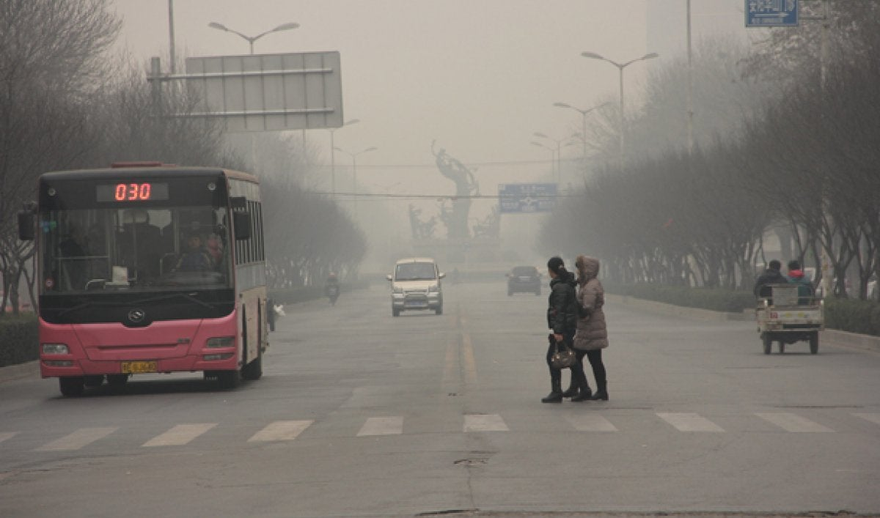
Tracking Air Pollution Levels in Bengaluru City DVST Project- Jan '22
Aarti Anant Madhavi – E22002
Monali Bendale – E22014
B Teja Sai – E22038
G.K.Nimalan-E22024

Slide 2
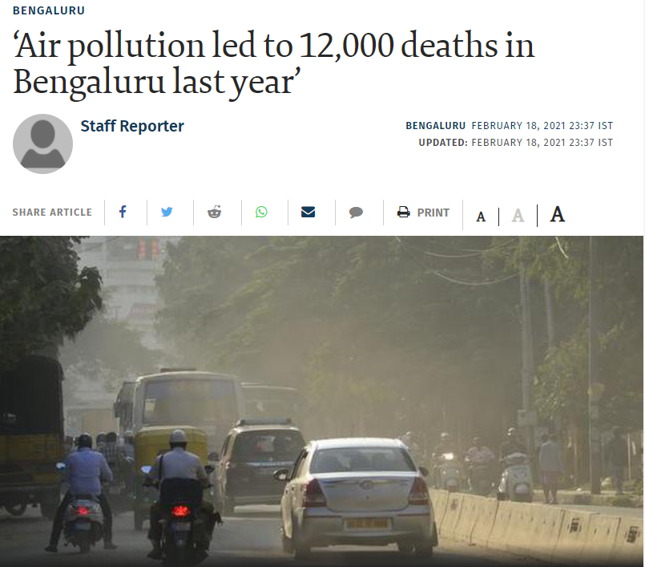
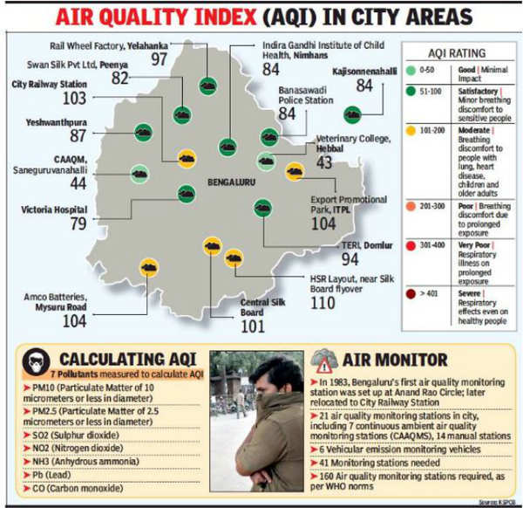
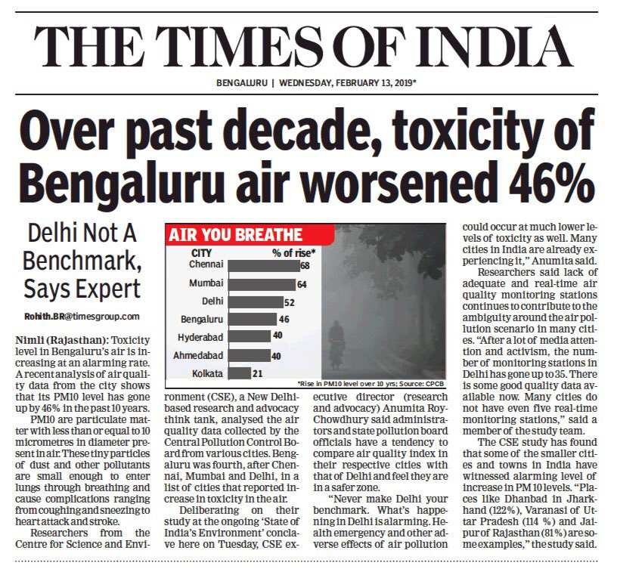

A grim situation evolving in Bengaluru City

Slide 3

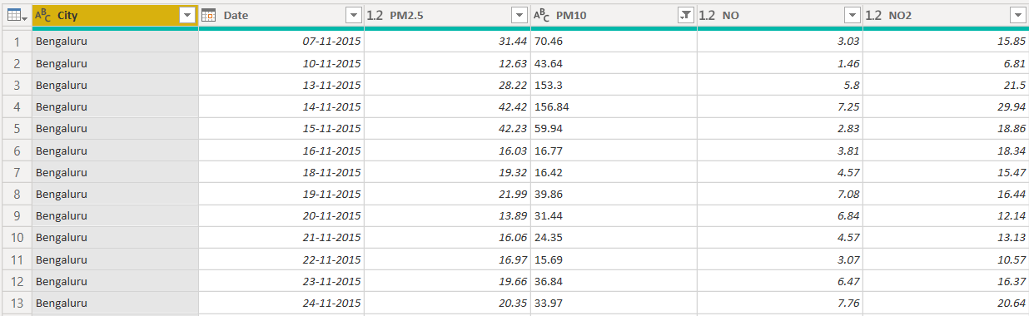
Air Quality Dataset

Slide 4
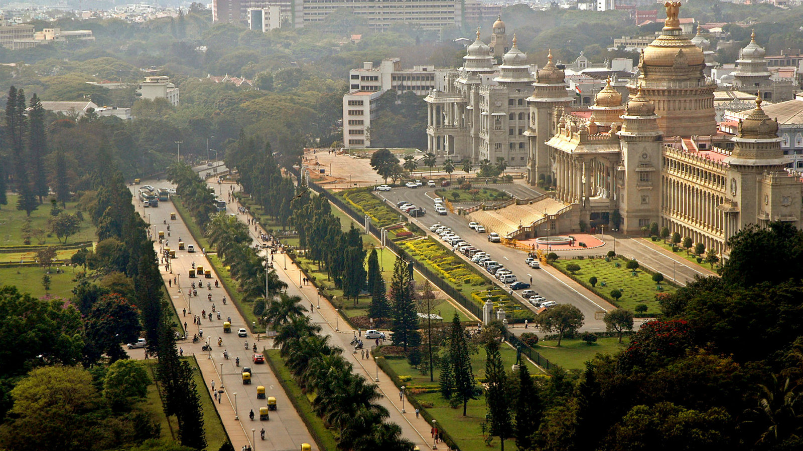
Questions for Hypotheses
1. What are the general pollution levels of Bengaluru city?
2. How are the air quality levels distributed across months?
3. Which month has the poorest ( and best) air quality? What could be the possible reasons?
4. Which areas of Bengaluru witness higher air pollution levels? Why is there a spatial disparity?
5. Which pollutants are frequently recorded in Bengaluru?

Slide 5
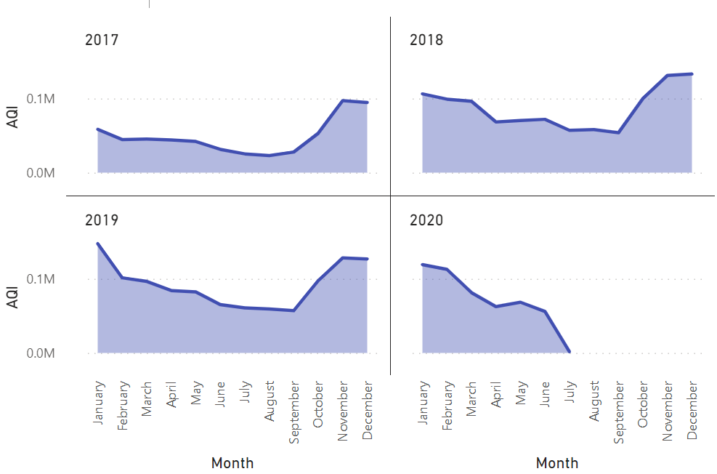
Yearly Analysis of Bengaluru AQI by month
Intuitive Understanding:
AQI from June- September is low mainly due to weather conditions.
The period coincides with the onset of Monsoon. Post September, the levels went up since it the transition phase between monsoon and winter.
Why do you think the AQI levels reduced in 2020?

Slide 6
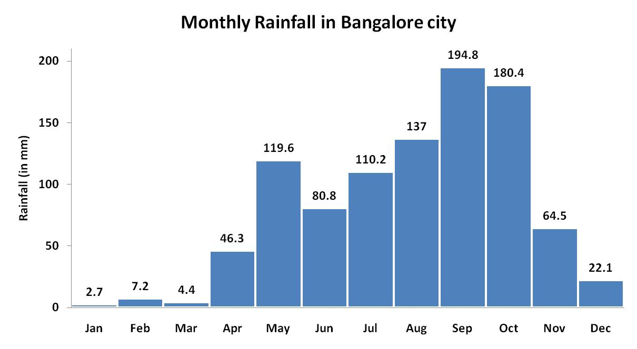
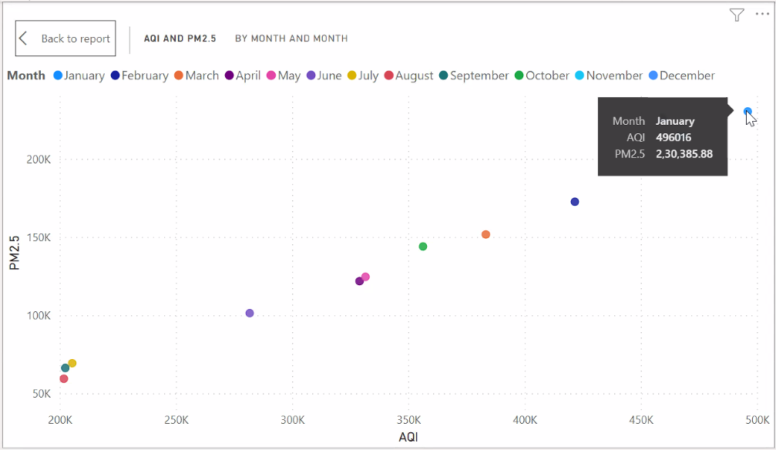


Slide 7
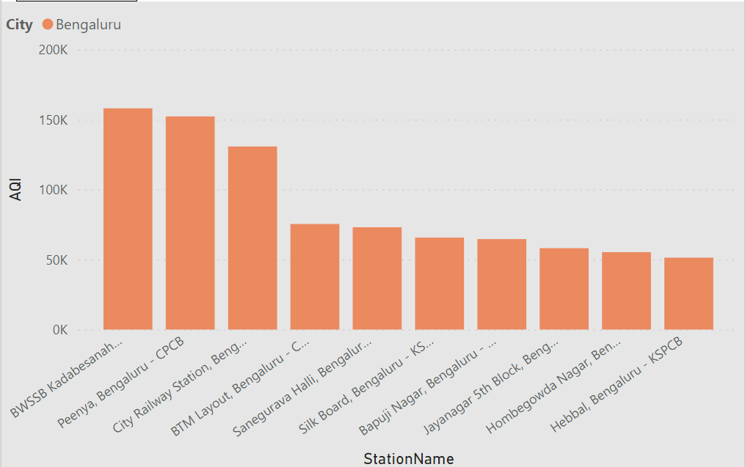
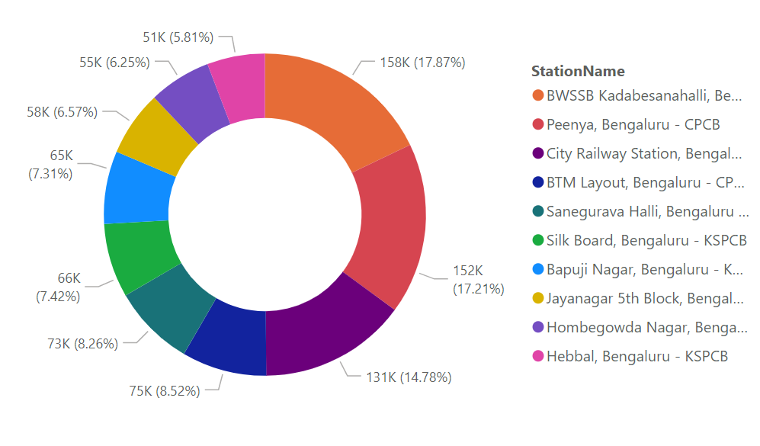
Area wise analysis

Slide 8
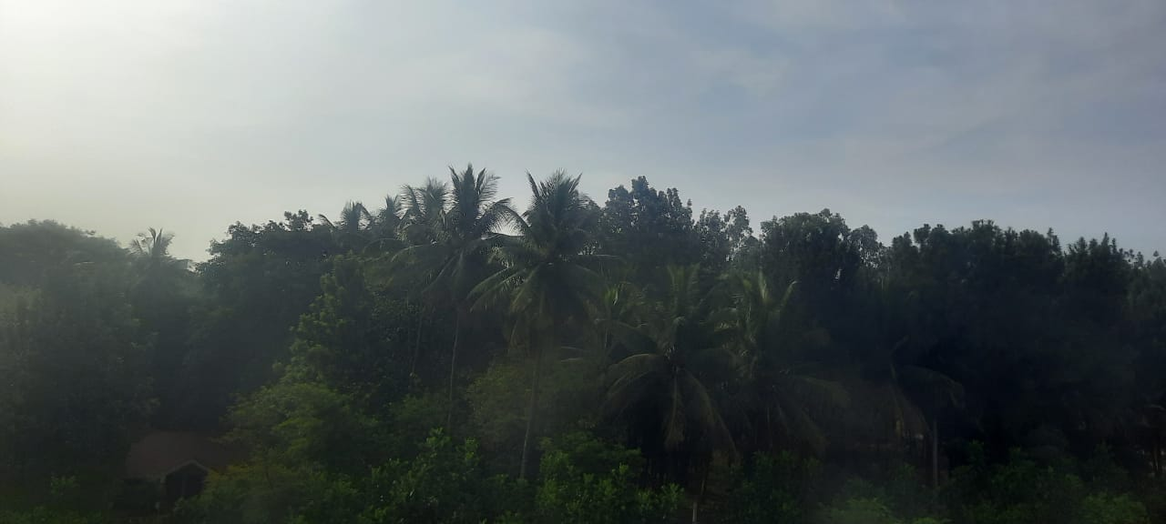
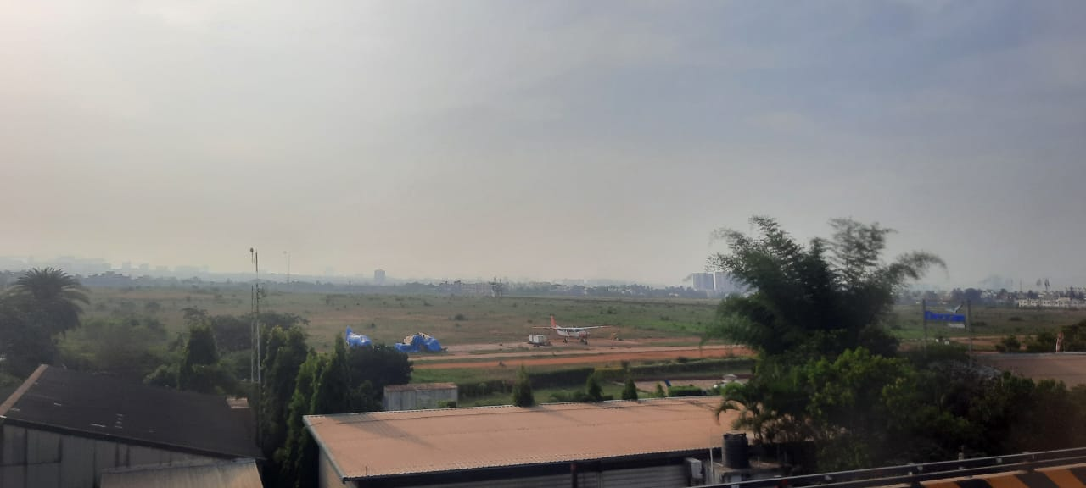
Intuitive Understanding:
Vehicular traffic and emission and burning of waste are the major reason for pollution in Bengaluru.
BWSSB, Peenya are the industrial Belt which correlate to the high air pollution.
Where do you think are the images on the right side, from?

Slide 9
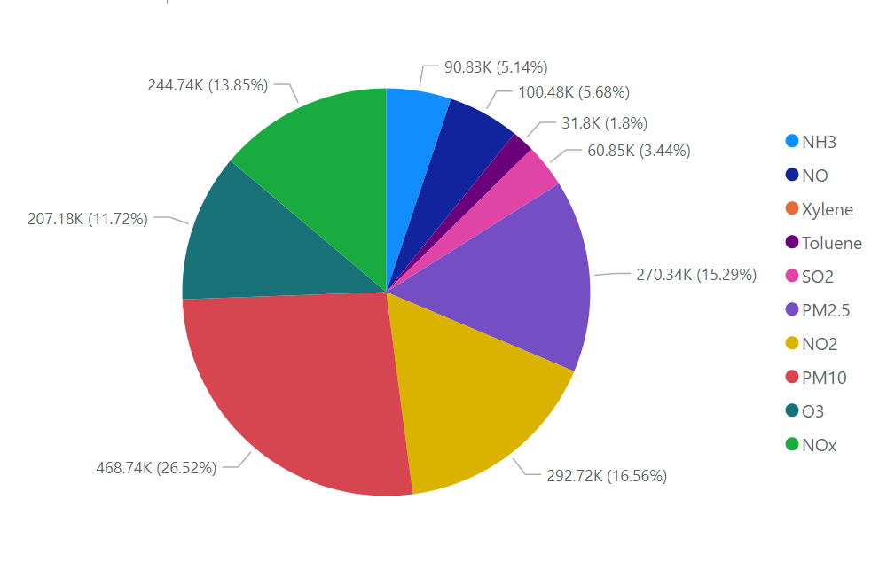
AQI Components

Slide 10
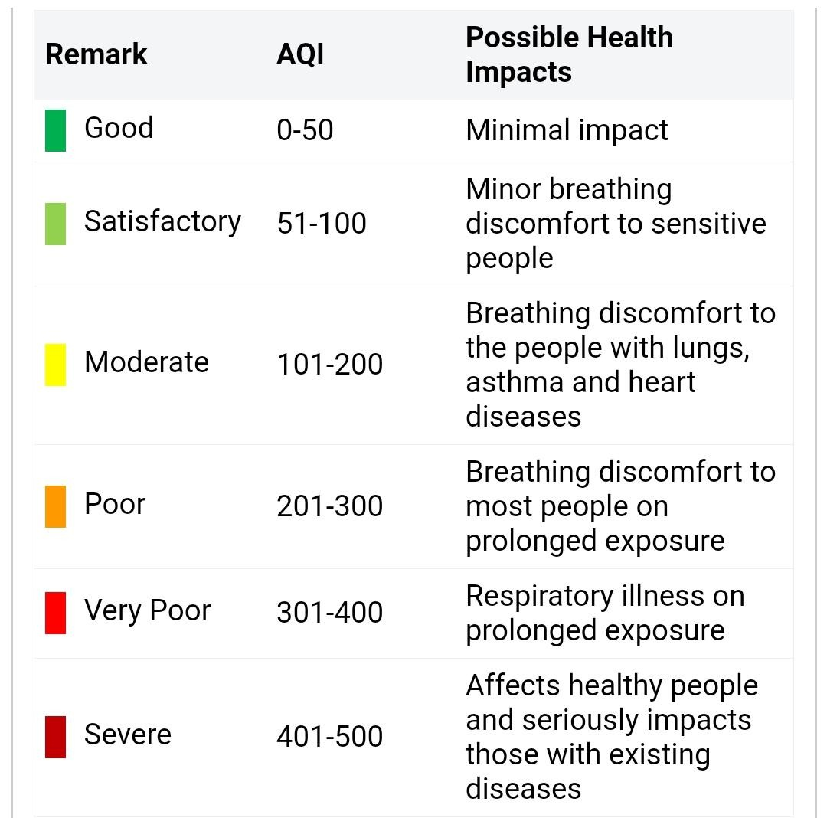
Intuitive Understanding:
AQI - air quality index tells us about our local air quality- how clean or unhealthy air is.
PM 2.5 and PM10 contribute in higher amounts to the AQI. Possible reasons: Transportation sector, waste burning, construction dust and so on.

Slide 11
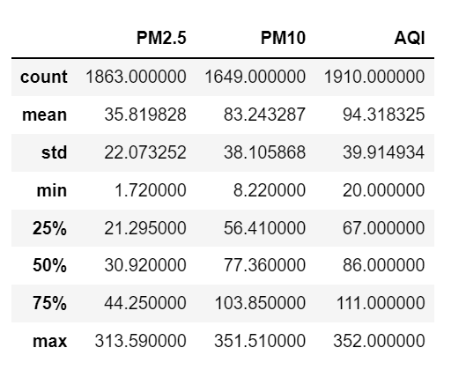
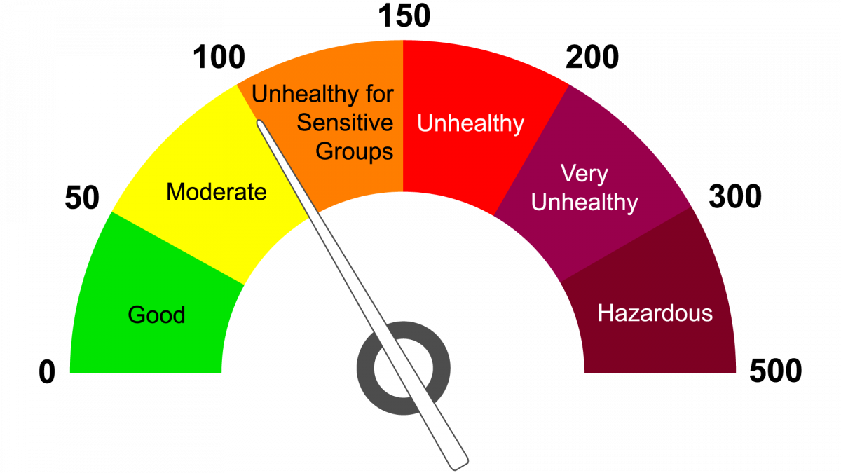
Summary Statistics of Bengaluru Air Quality(2015-2020)
According to WHO ,The acceptable average daily concentration for PM10 dust is 50 µg / m3.
The acceptable average daily concentration for PM2.5 dust is 25 µg / m3.

Slide 12
Conclusion
There are clear spurts in AQI levels across the months in Bengaluru. There can be a Graded Response Action Plan (GRAP) on the lines of Delhi.
The spatial disparity in good air quality needs to be addressed. There should be sustained air pollution control and mitigation, especially in industrial and backward areas.
Among the components of AQI, PM2.5 and PM10 warrant the most attention (apart from NO2).
Comprehensive measures like the 44-point joint action plan approved by Karnataka Air Quality Monitoring Committee (AQMC), need to be augmented by civil society and CSR support.

Slide 13
Selected References:
https://www.thehindu.com/news/cities/bangalore/air-pollution-led-to-12000-deaths-in-bengaluru-last-year/article33874517.ece
https://aqicn.org/city/bangalore/
https://www.researchgate.net/publication/292643438_Air_Quality_Index__A_Comparative_Study_for_Assessing_the_Status_of_Air_Quality
https://bengaluru.citizenmatters.in/how-bengalurus-action-plan-proposes-to-beat-air-pollution-35162

